Slide 1
Binomial Theorem

Slide 2
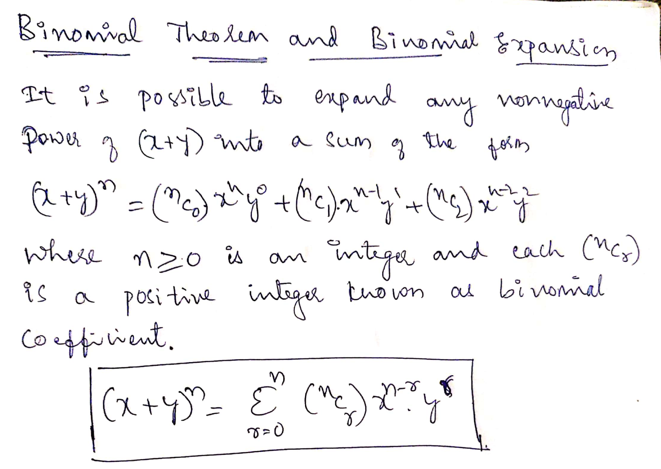

Slide 3
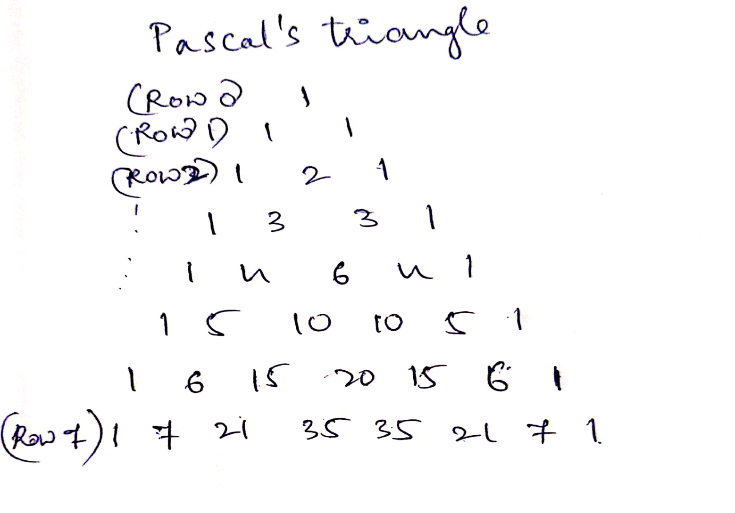

Slide 4
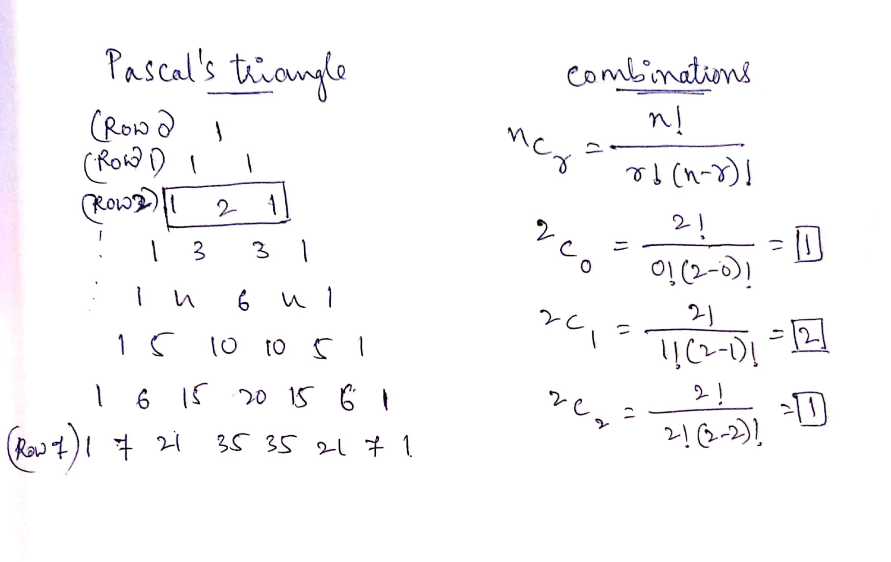

Slide 5
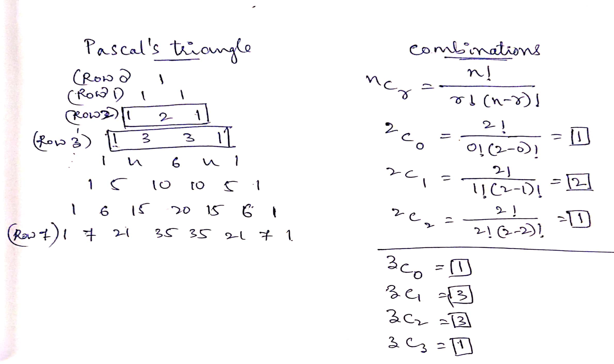

Slide 6
Now you know,
n= Row Number and r= 0 to n
Terms in 7th row??
Terms in 8th row??
Are you going to draw pascal’s triangle or use combinations?

Slide 7
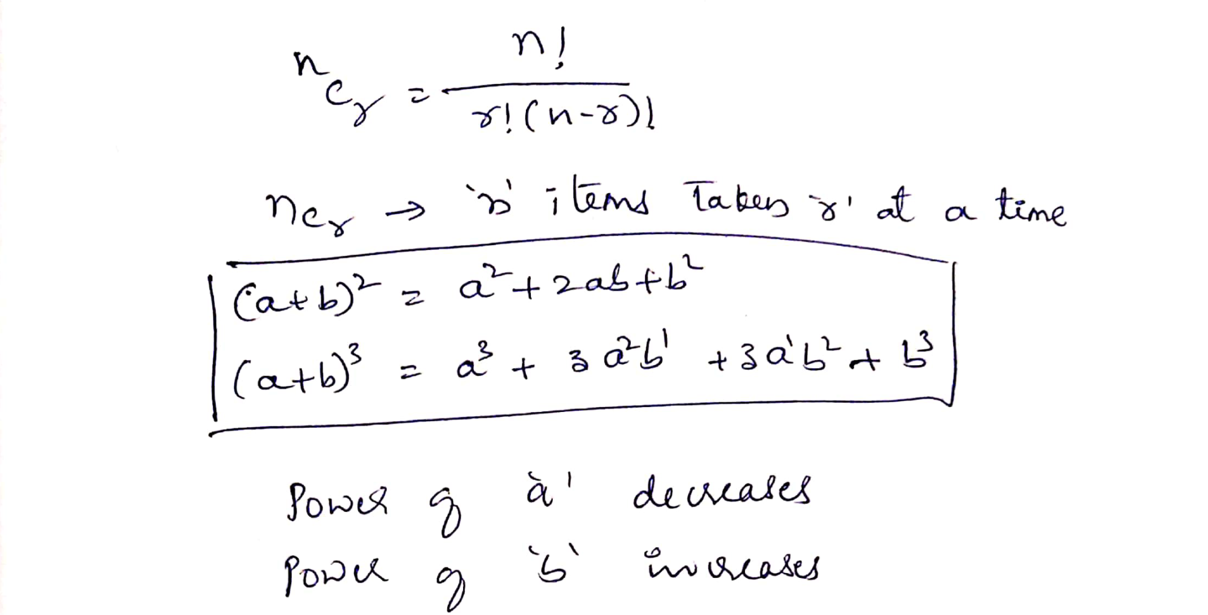

Slide 8
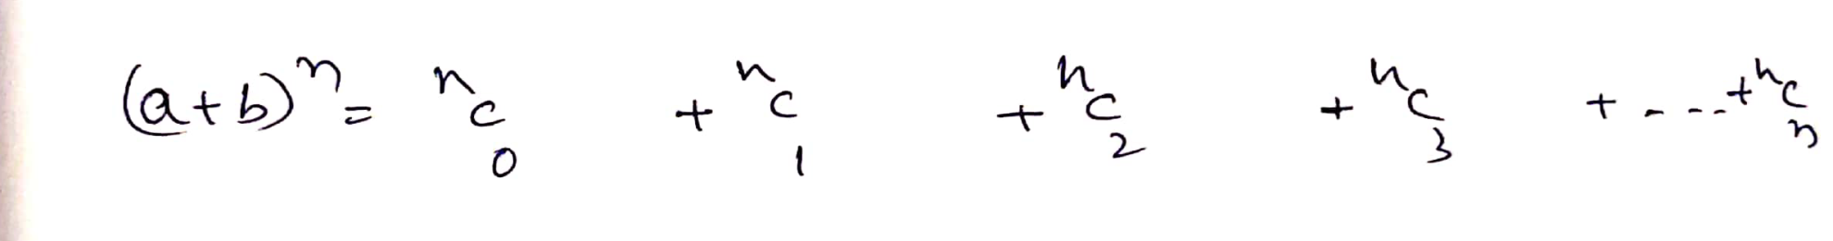

Slide 9
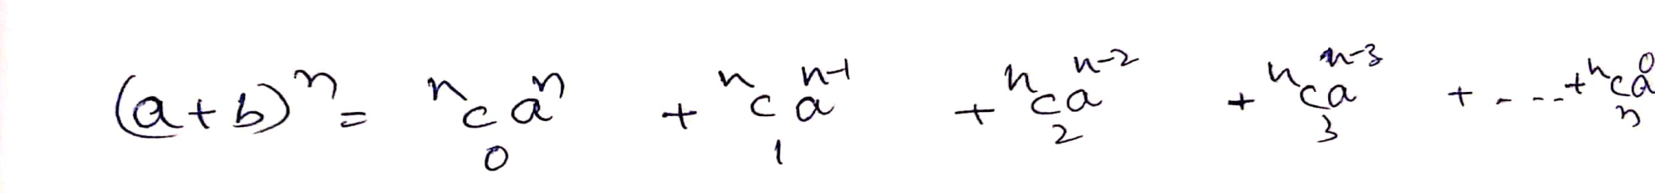

Slide 11
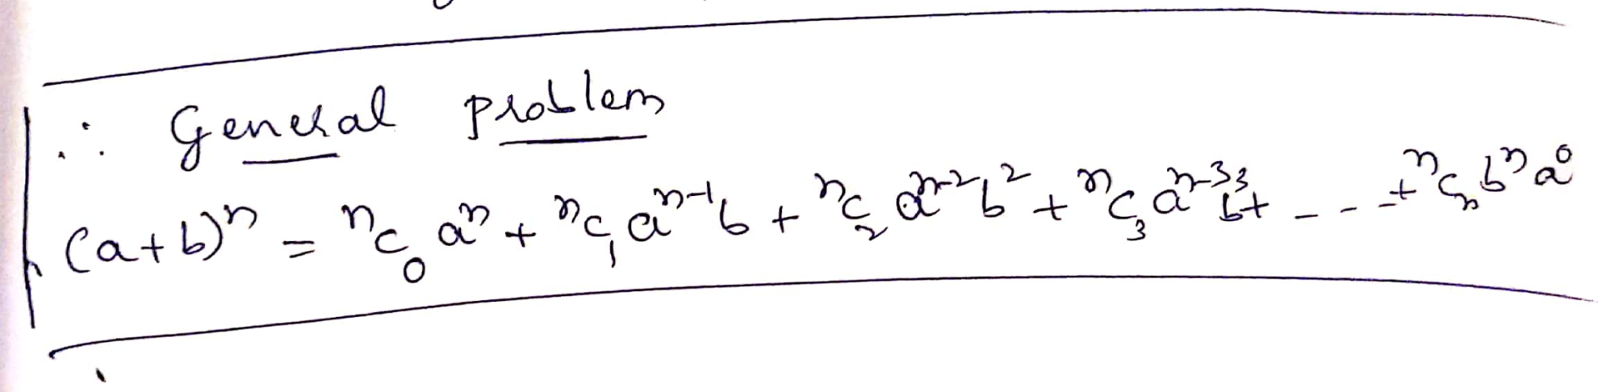

Slide 12
